Slide 1



Data Analytics
Full-Time Bootcamp
PRESENTATION AND COURSE OVERVIEW

Slide 2
WELCOME

Slide 3

Welcome - meet the students
Look around. Over the next 9 weeks you will be spending more time with these people than with your family. Get to know them. With the right attitude, they can easily become the most important learning and emotional pillar you have here.
Let’s go around and
State your name, background and expectations
Share a fun fact about yourself
Welcome

Slide 4




Welcome - meet the teachers
JAN MOLENDIJK
ERIN BERARDI
MIGUEL FERREIRA
PHILIP KITCHENER
Welcome

Slide 5
IRONVALUES AND INTERACTIONS

Slide 6
What we value - Towards others
Not high school
The goal is to
LEARN
Respect
Help
Listen
Learn
Not college
You gain more by PULLING OTHERS than by pushing yourself
Not work
Ironvalues

Slide 7

What we value - Towards yourself
Work hard
Talk to us
Enjoy
Ironvalues

Slide 8
Feedback

Slide 9
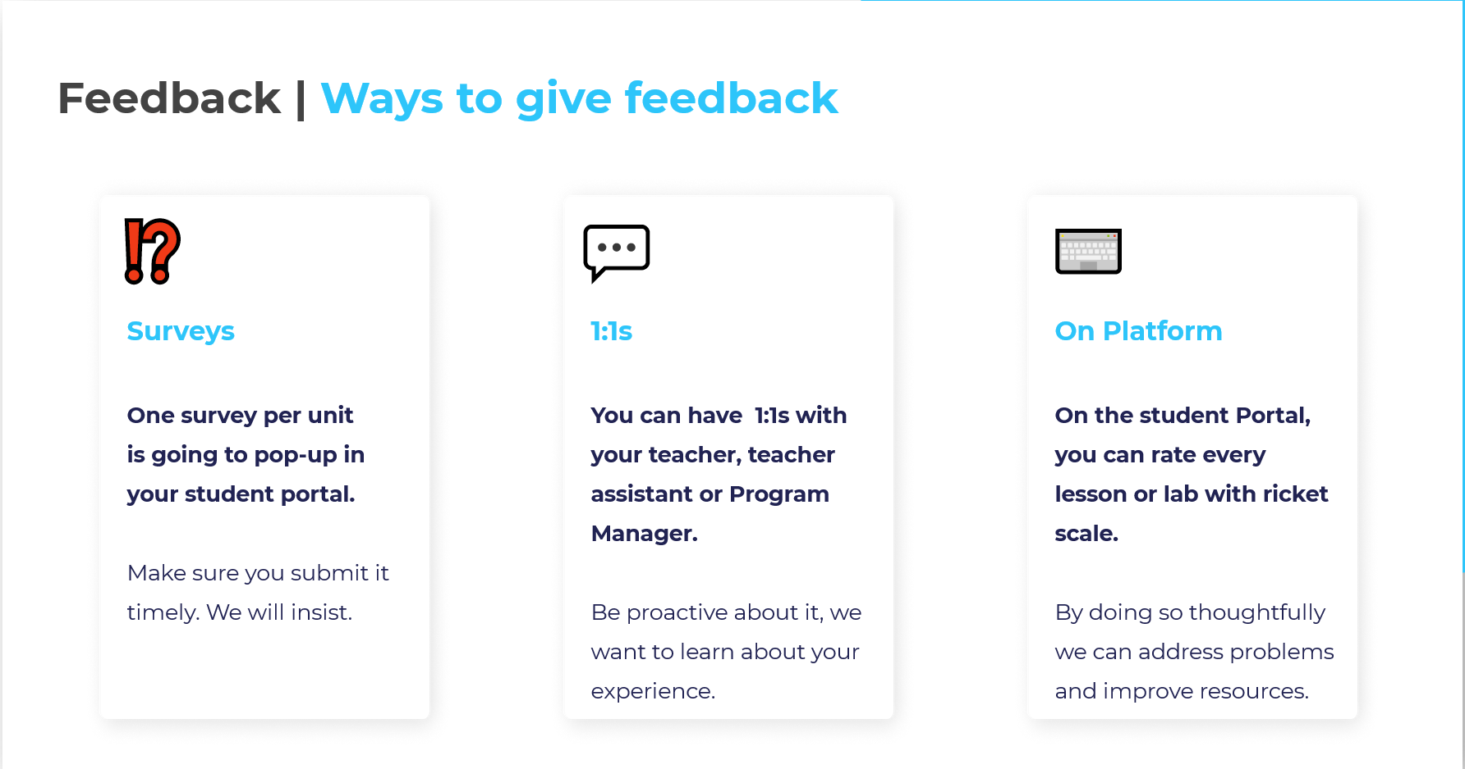
Feedback

Slide 10
DATA DAY TO DAY

Slide 11
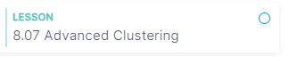
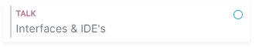
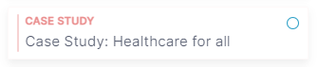
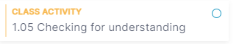
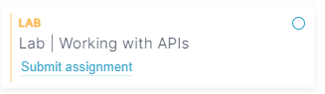
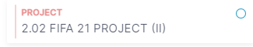
Types of classes
Day to Day

Slide 12
Types of classes
Lessons
Lessons are the moments where
course content will be taught.
The content will be varied but the
objective is that these sessions are
"hands-on" and/or code along
Day to Day

Slide 13
Types of classes
Class Activities
Class activities are typically small 10-15 mins exercises that are a direct application of the contents just discussed in class.
They are a means to exercise your generalization power, not exercises to judge your progress
Day to Day

Slide 14
Types of classes
Labs
This is where the magic happens - in the labs you will be faced with several challenges about the topics taught and will learn at your own pace. A lab is not an exercise session to test your understanding, it’s a moment to learn how to solve problems on your own.
Some guidelines:
Don't be afraid, it’s supposed to be hard!
Help and get help from your fellow Ironhackers
Don’t expect to know everything just with the content from the corresponding lesson
Day to Day

Slide 15
Types of classes
Case Study
Every week our classes will be geared towards solving an overarching problem.
In the case study classes we discuss the problem at hand, the goals, limitations of our approaches so far and how we will go about solving it.
Day to Day

Slide 16
Types of classes
Project
Projects are the ideal moments to combine what you learnt with your own Data style and interests
Projects are followed by by a presentation to the class
During projects you will be expected to be more independent. There will be less direction on our side and more problem solving on your part
Day to Day

Slide 17
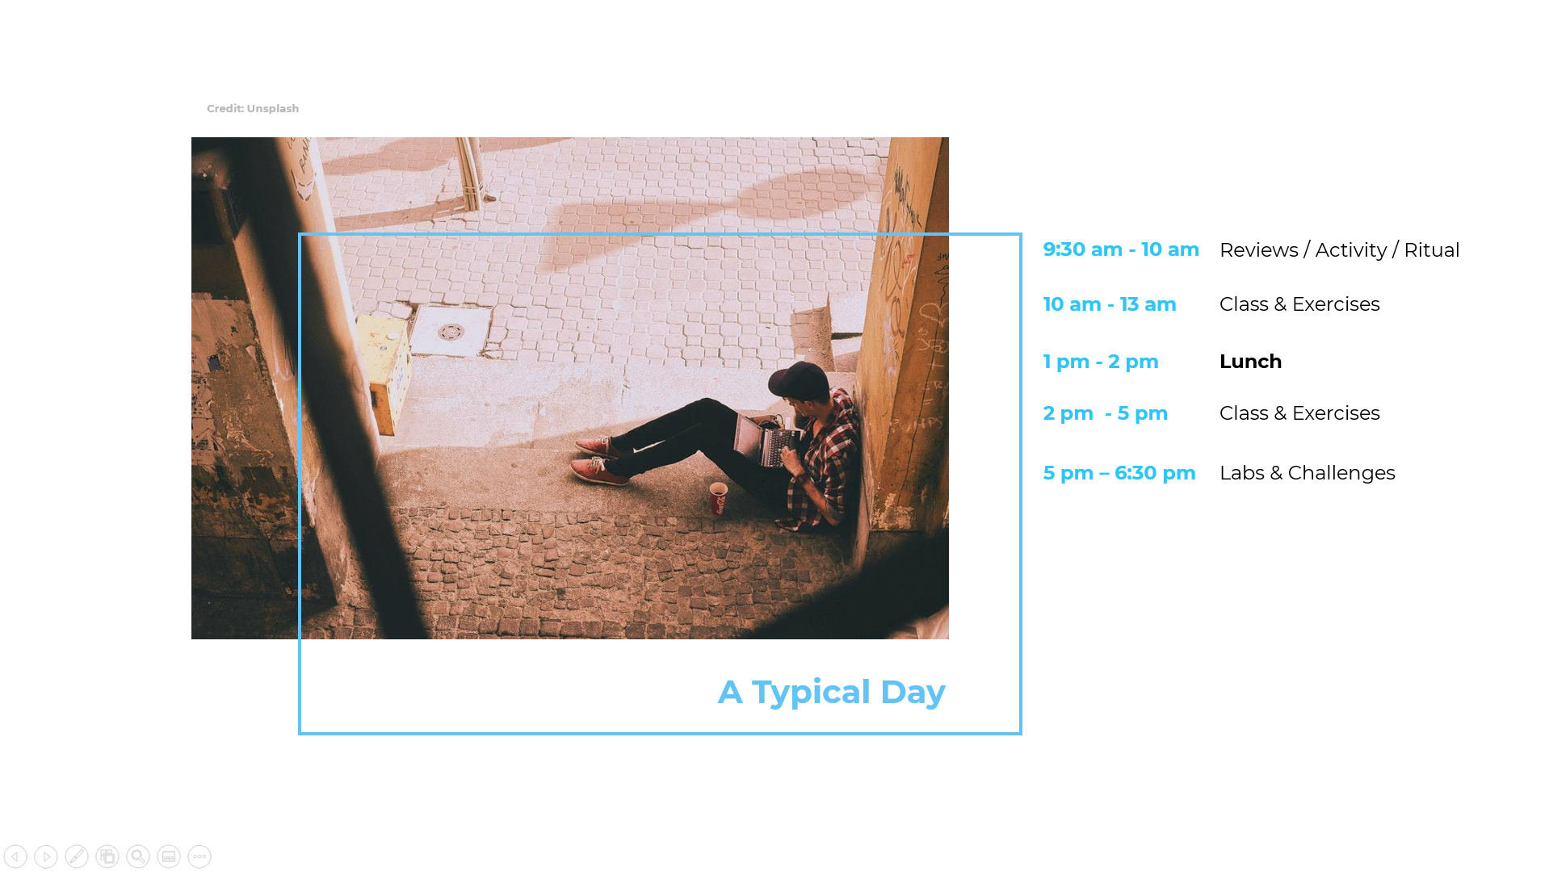

Slide 18
Day to day vs the Big Picture
To Graduate you must
● Complete all the requirements for all your projects on time.
● Successfully turn in your labs
● Follow code of conduct
● Miss no more than 3 days of class
- 3 tardies is one skipped day.
Depending on the day you may not be able to complete all labs at once. That is expected.
You should strive, however, to submit something by the end of the day for each lab and start each week up to date on labs.
Believe us when we tell you that letting it snowball is much worse.
If you need to skip a day or some time, please let us know as soon as possible via slack, message or email.
Day to Day

Slide 19
The question funnel
Feeling stuck? Banging your head on why your code is not coming up with the answer you expect? Feeling like you are missing something to understand a particular statistical concept? No worries, we’ve all been there. Heck, I’m there 90% of my waking time.
Whenever you feel like you need help, reach out! But do it in a smart way, follow the question funnel:
Course Materials
Online resources
Cohort
TA / LT
The more to the left in the funnel a resource is, the more likely it is to both be available at a moment’s notice and to have a solution that matches your problem. We expect you to follow this funnel in your day to day as a way to both increase your problem solving independence and optimize class resources.
Day to Day

Slide 20
The question funnel
Course Materials
The course materials are designed to give you a self contained overview of the most common concepts, tools and methodologies in modern Data Analytics.
If your problem is common (and, statistically, most of your problems will be common) then it is likely addressed in some of the course material. Review the code for the corresponding lesson, check the slides or the reading material. Is there anything pertaining to your problem there?
Day to Day

Slide 21
The question funnel
Online resources
There are 7 BILLION people in the planet. One of them is bound to have had the same issue that you are having now. It is extremely rare that pasting an error message in Google does not churn out an explanation and work around. Most times even asking explicit “how to” questions produces a viable answer.
There are a few community resources below, but 99% of the time Google will lead you to them anyway:
www.stackoverflow.com - the de facto standard for programming questions and answers, both basic and advanced. I spend more time here than in any other site
Towards data science - a Medium space with in-depth tutorials and discussions on data science topics. Usually accompanied by code so you can code along and see the solutions work
Youtube - maybe not obvious, and difficult to get via google, but video tutorials are an extremely powerful and condensed way to quickly get what you need to do
API documentation - google “function”+”package”. Not surprisingly, most of the package developers want you to be able to use their tools and have gone through great pains to document their functionality in official repositories
Day to Day

Slide 22
The question funnel
Cohort
If we reach this point in the funnel we are getting at probably very specific or complicated problems. Chances are that it pays to have the answer written down or properly explained, so please go into the cohort’s Slack channel and open a new question.
Please check regularly slack or our shared resources so you can see if there are questions there you can answer (we will do the same).
Whenever you answer a class question, you get bragging rights :)
Day to Day

Slide 23
The question funnel
TA / LT
We are genuinely happy to help you clear hurdles that you may face (this is why we became educators in the first place, of course!), but be aware that the “teacher” is a figure that does not exist in real life, so try to use us sparingly to exercise your problem solving muscles properly.
Also, be aware that we are a finite resource to be divided by all of you - so be considerate of your colleagues who may be showing moderation in the calls for help.
Obviously, if you are genuinely blocked or if you want to discuss some matter in more detail, never hesitate to loop us in. Just be aware that we reserve the right to ask about preceding elements of the funnel. “What did you find on the internet about it?”, “How did other people in the group make it work”, etc.
Day to Day

Slide 24
DATA COURSE OVERVIEW

Slide 25
A word of warning: humankind plans and the gods laugh...

Slide 26
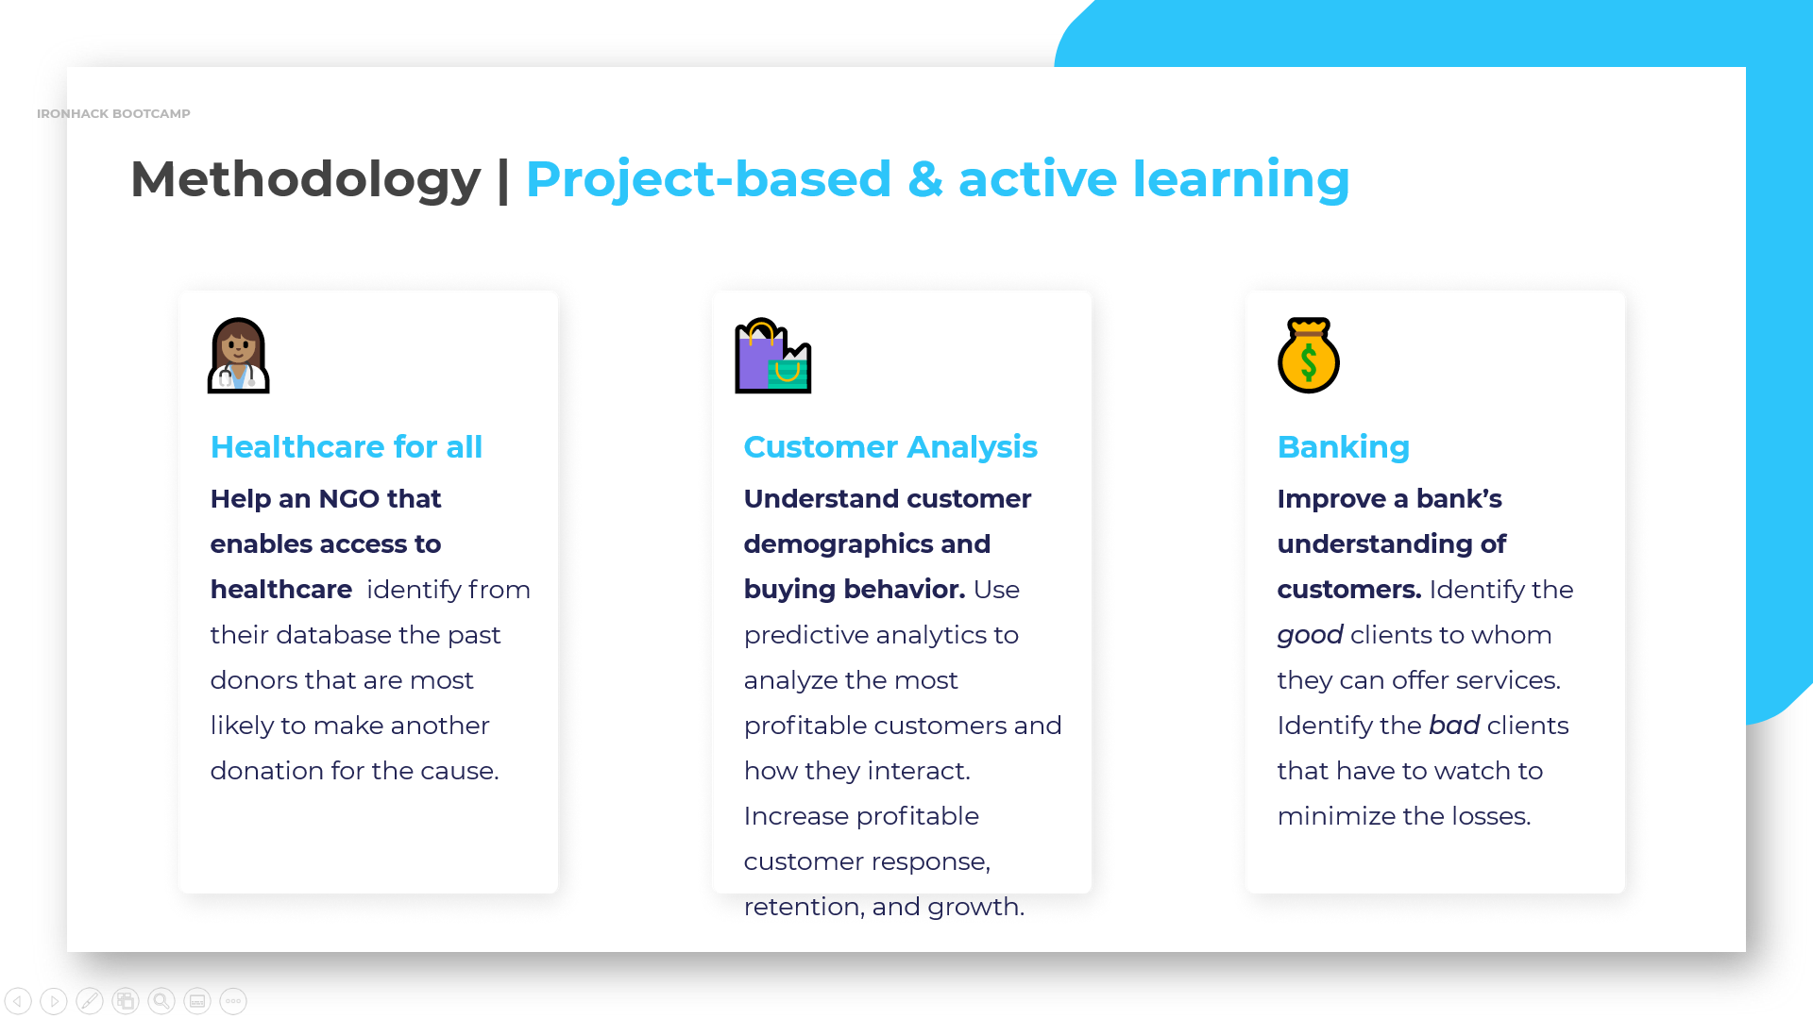

Slide 27
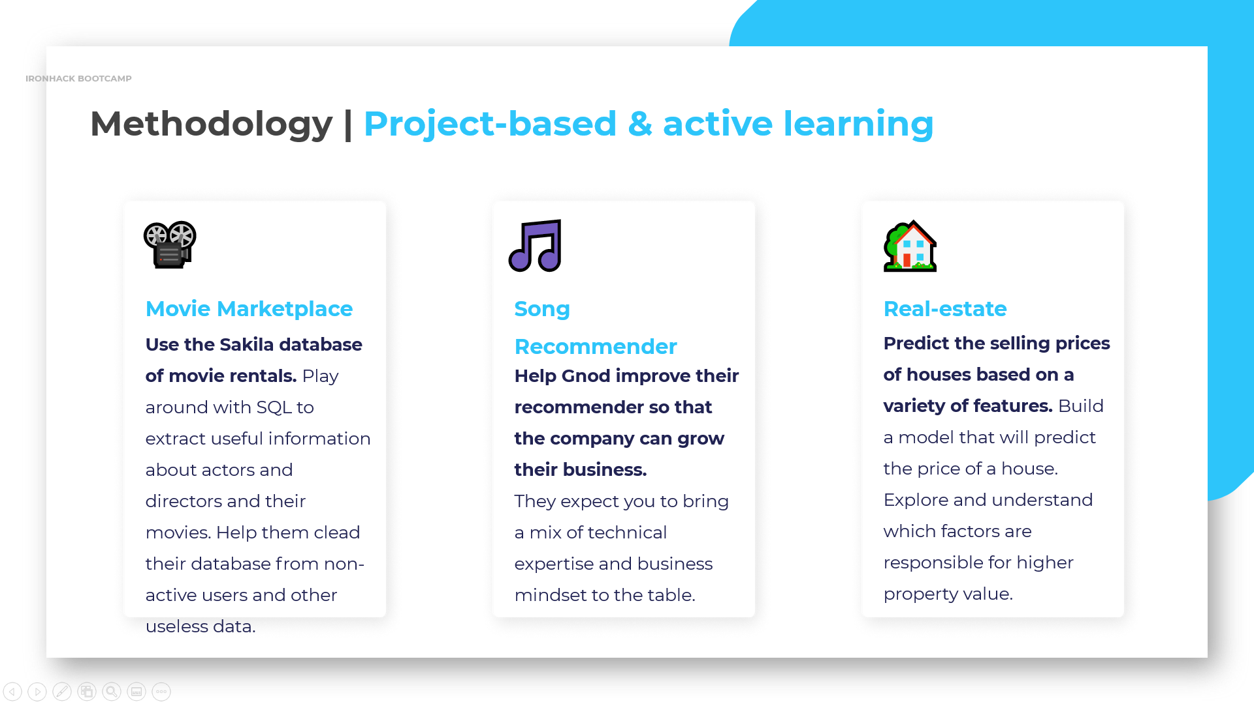

Slide 28
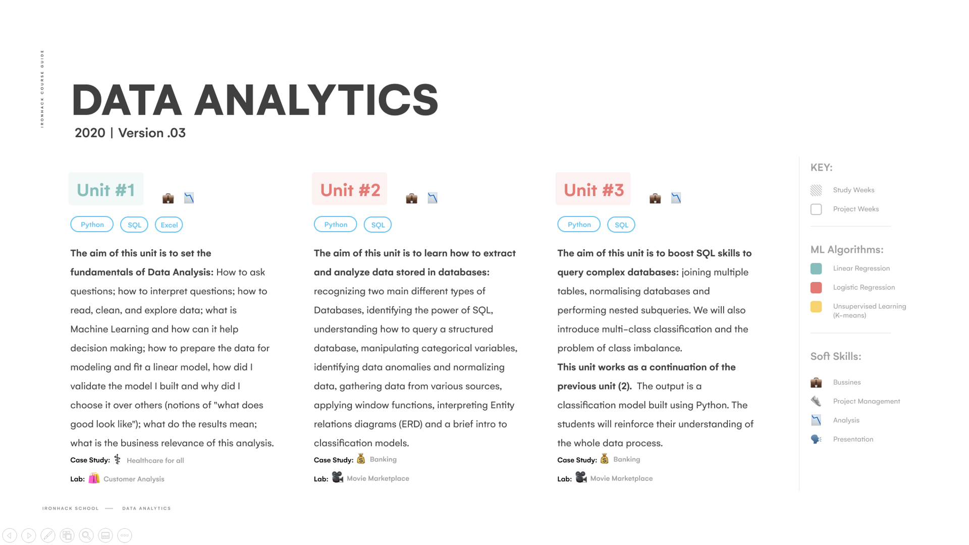

Slide 29
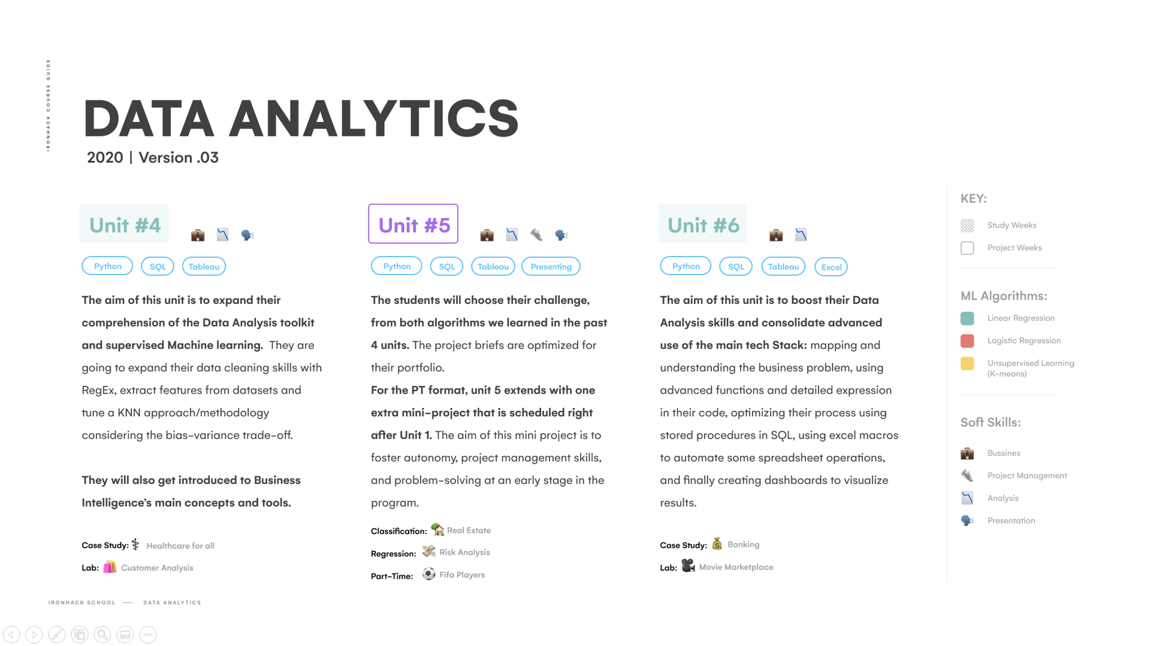

Slide 30
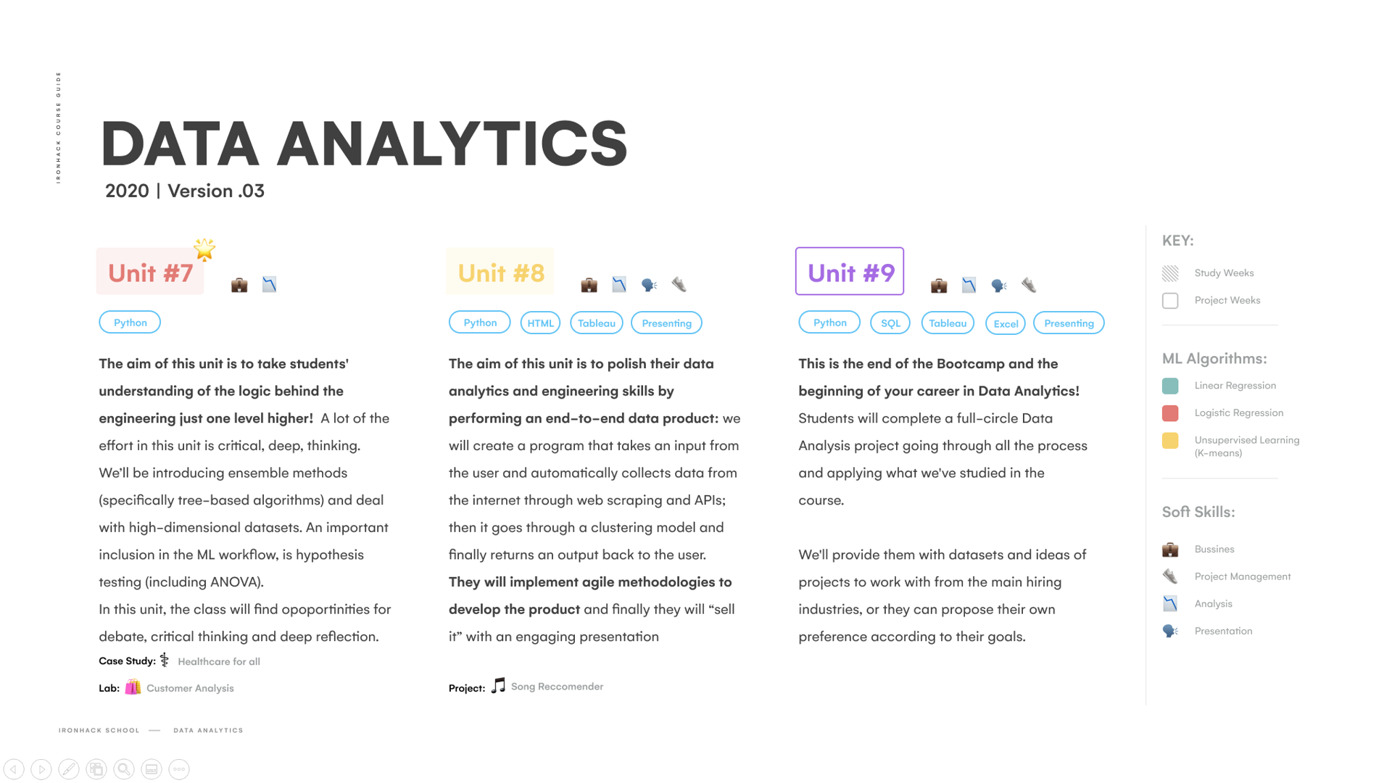

Slide 31
TOOLS & RESOURCES

Slide 32
Tool checklist
Make sure you have, in the coming days, access to the following tools. All installation options can be left on default.
For solutions that require registration, please make sure your profile makes it clear to your colleagues who you are and that you are easy to find. Also kindly inform our TAs of your handles for these accounts so they can find you.
A slack account and app
Python w/ Jupyter Notebook
MySQL workbench
GIT
A GitHub account
Tableau public desktop edition
Tableau public account
Office 365
Google Colab plugin
It is also recommended but not necessary to have a python IDE (like Spyder or VScode) and a Zoom account. You may also want to install the Anaconda package and environment manager, but once again, this is not a requirement.
Tools & Resources

Slide 33
ARE YOU READY?

